Slide 1


VAXINE TIME

Slide 2
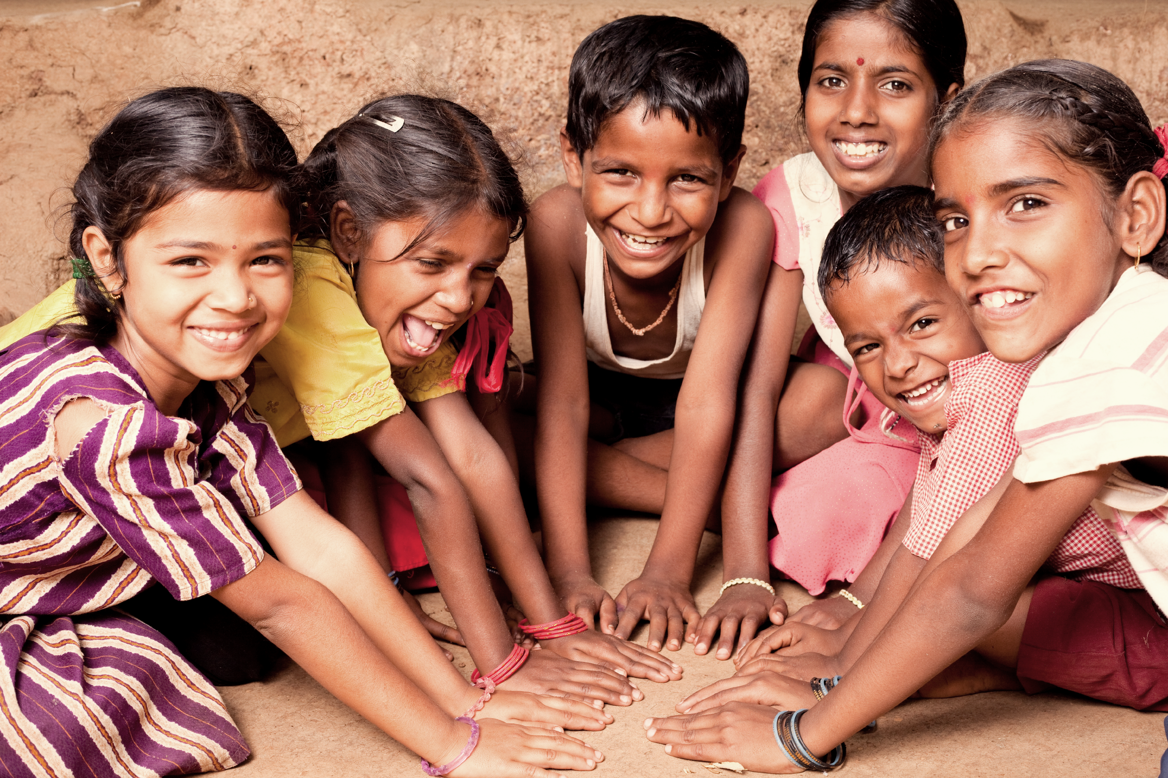
VAXINE_TIME
Team Members:
Shivam Kumar
Vikas Kumar
Nikhil Teotia
Aparna Agrawal
Aditi Shahane
Vanshaj Nagrath
Poona College of Pharmacy,
BVDU, Pune

Slide 3
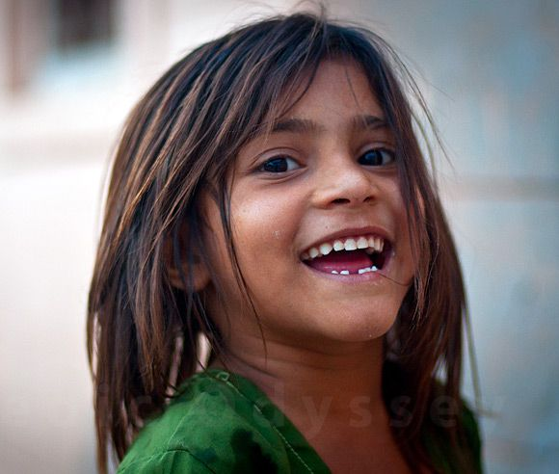

Ministry/ Organization name: Ministry of Health and Family welfare
Problem Statement
SS41: DIGITAL tracking of children of migrant population for immunization services.

Slide 4
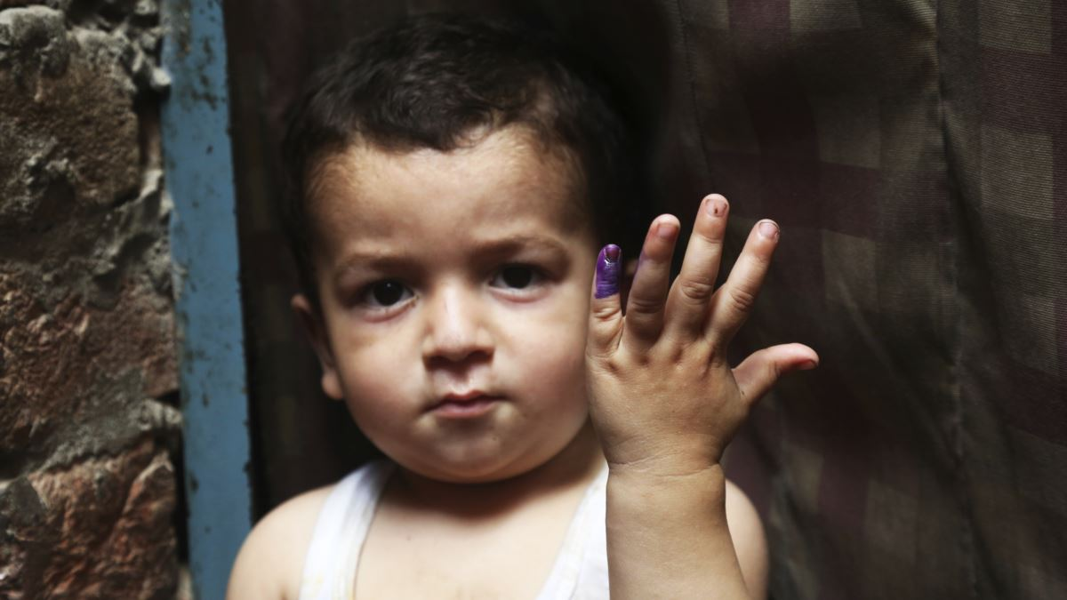
INTRODUCTION
Harnessing the power of digital technologies is essential for achieving the Sustainable Development Goals, including universal health coverage.
To reduce the inequities in health in population with the migration either because of occupation, shelter or some other reasons, migration among cities, states, rural to urban, it is essential to track their health record so that health services can reach up to such people in the form of continuum of care.
Immunization of children is an important field where we can provide full immunization coverage to such community who are often left behind.

Slide 5

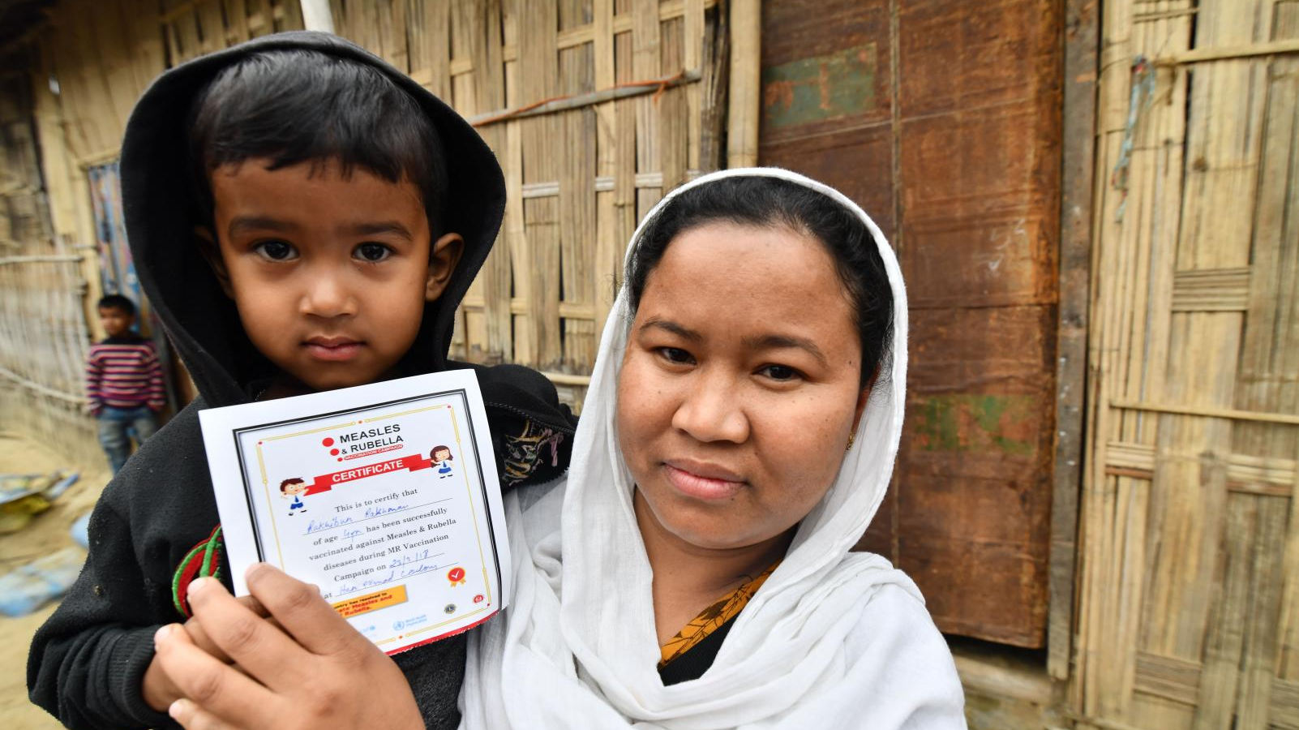
IDEA towards the problem
To track the immunization services and health records of a child of migrant parent, there is need to register the child during its birth or while his/her first vaccination at the hospital by a unique id(i.e. AADHAR card), so that child vaccination history can be easily tracked.
And, this vaccination history can be tracked from any registered hospital of India.

Slide 6
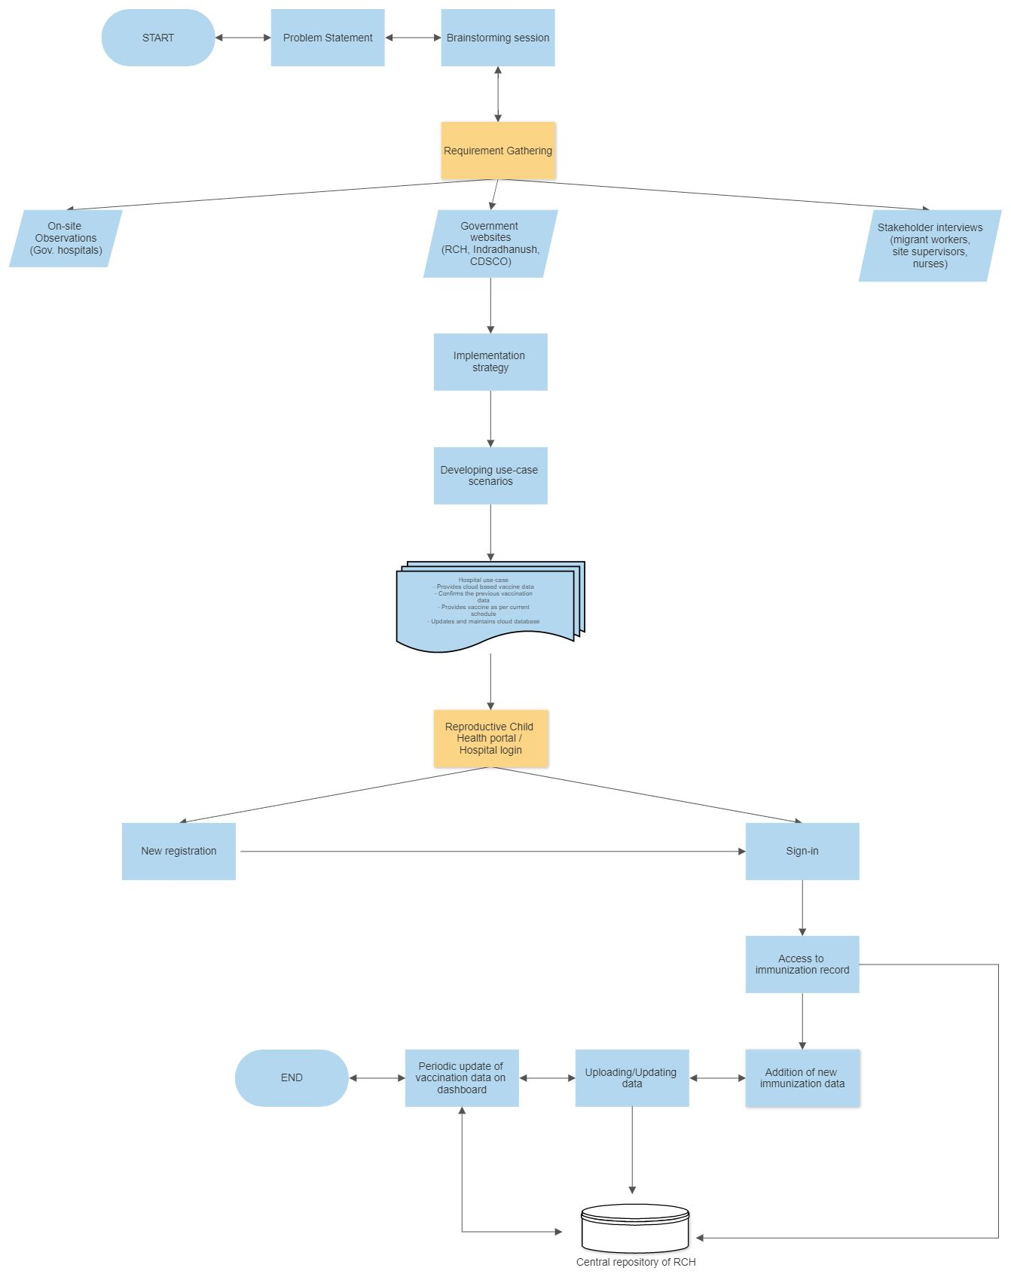

Slide 7
Hospital use-case :
Provides cloud-based vaccine data
Confirms the previous vaccination data
Provides vaccine as per current schedule
Updates and maintains cloud database

Slide 8
Users
HOSPITAL
Register the child.
Manage child vaccination details
Track the vaccination statistics from dashboard

Slide 9
Technical Requirements
Smart phones : Android/ Windows/iOS/
OR
Laptop/Computer
Internet Connectivity
Interactive kiosk with 32 “ screen -with built in QR code reader , figure print reader for Aadhar card.(For hospitals only)

Slide 10

Screenshots

Slide 11
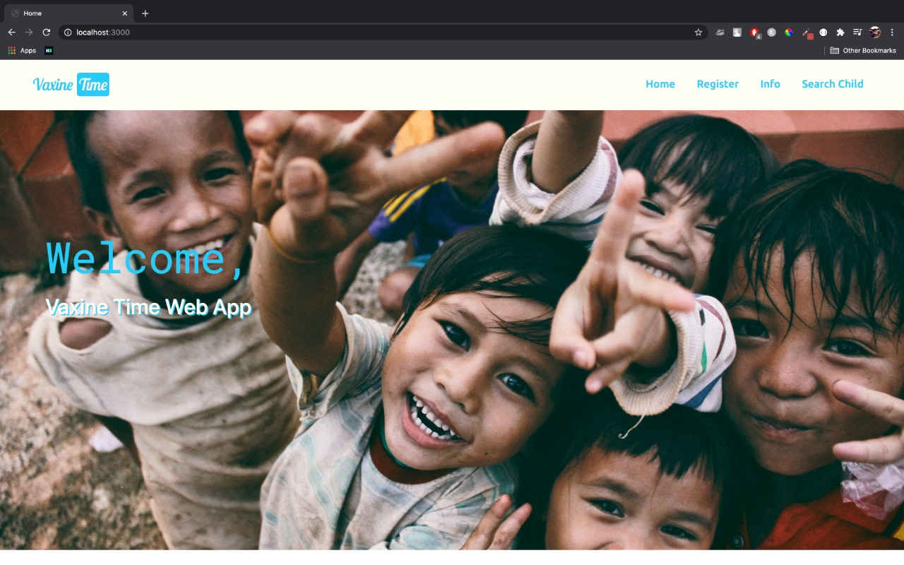
Index Page

Slide 12
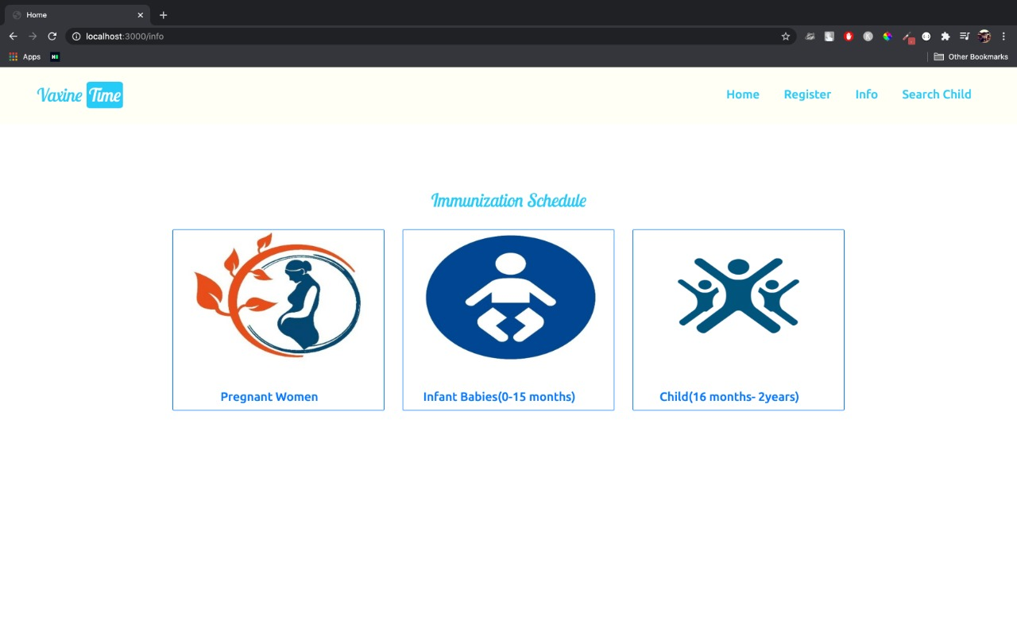
Information about Vaccines

Slide 13
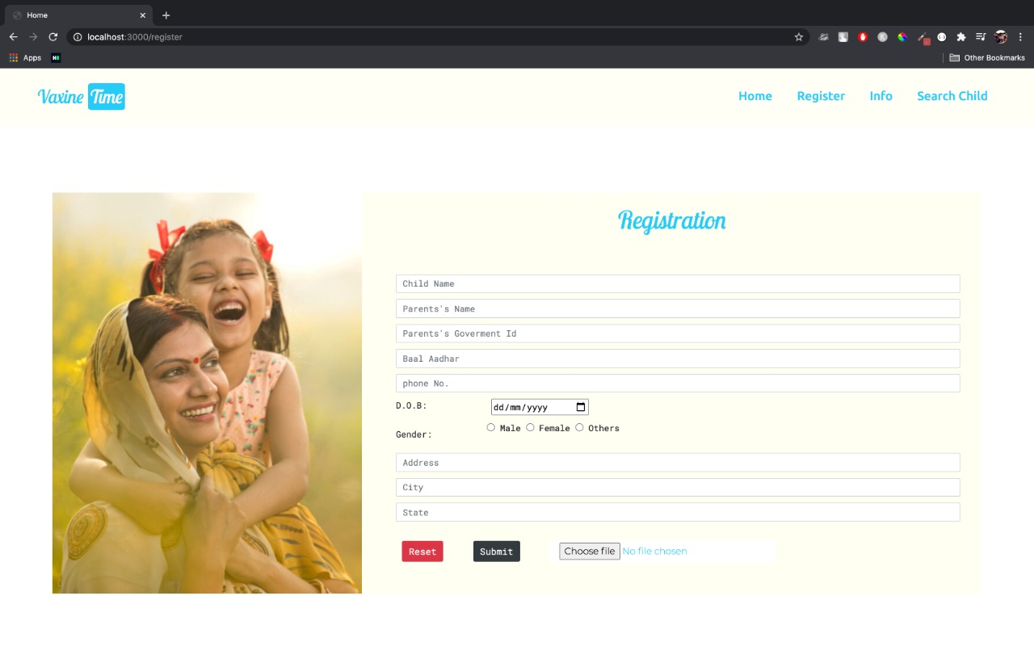
Registration

Slide 14
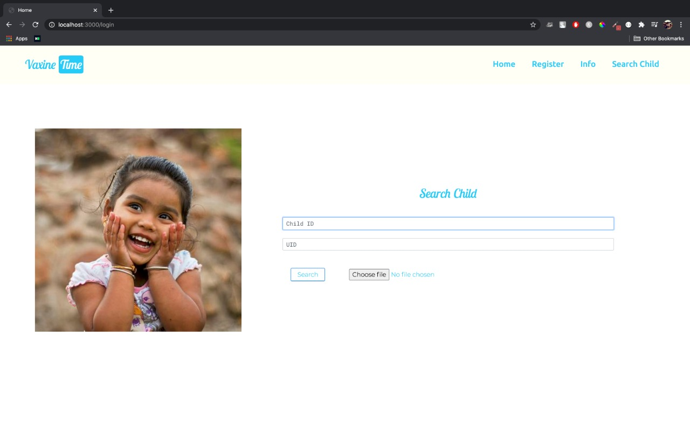
Login

Slide 15
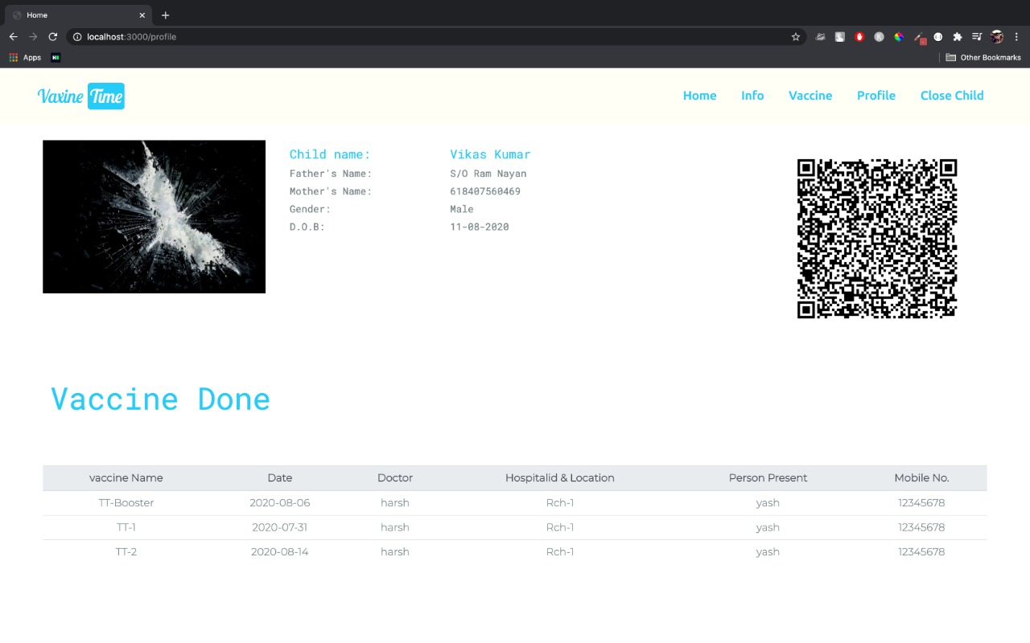
User Profile

Slide 16
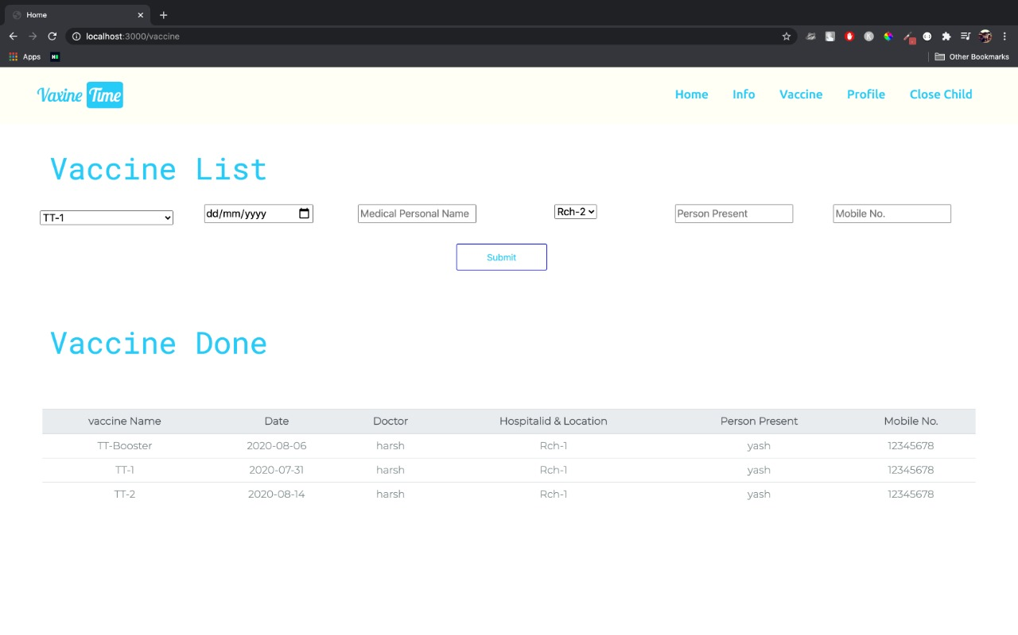
Vaccine List

Slide 17
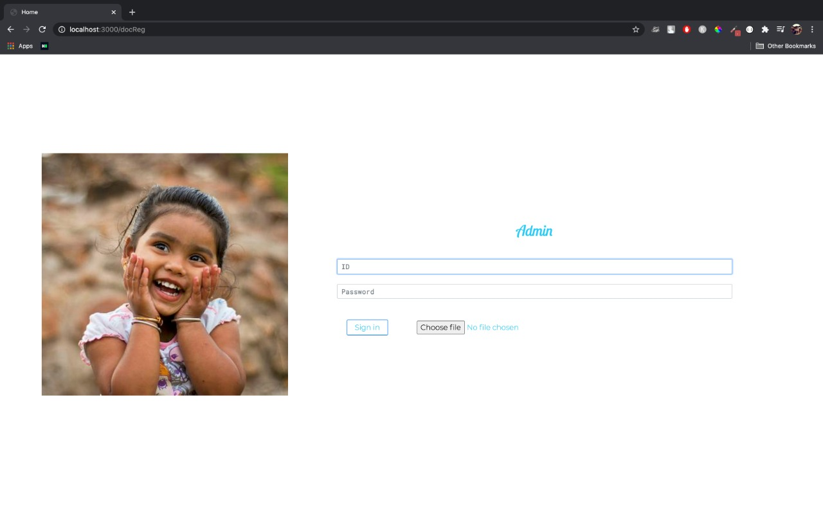
Admin Login

Slide 18
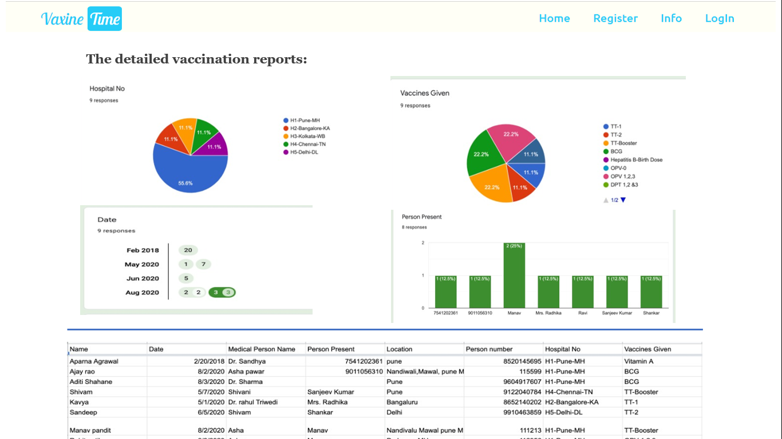
Dashboard

Slide 19
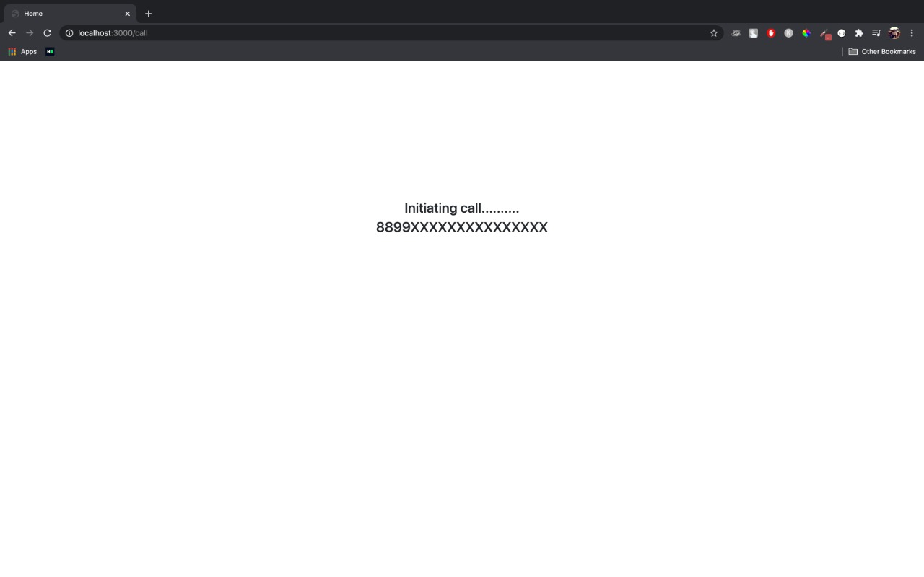
Calling

Slide 20
Problems Solved
Complete Immunization record is accessible to authorized hospital staff.
No need to learn the completely new system as we are planning to integrate our system with RCH portal.
Use of Bal Aadhar and RCH ID helps to track the child and mother easily and accurately.
Vaccination history is accessible from any location of India.
Tracking of hospital/Clinics/Aanganwadi where vaccine was administered.
Report on the dashboard helps to get the statistics about the vaccination in various states and get insights about the vaccination status .

Slide 21
Future Scope
Migrant workers Ration card
E health Card Services – Digital Lockers
RCH – web Site
Reproductive & Child Health Care
INDRADHANUSH SYSTEM Summary
IVR system implementation
S Y S T E M I N T E G R A T O R T E A M L E A D

Slide 22
Development timelines and Fees
Description | Stage I | Stage II | Stage III | Total Fees Estimated (L)
New web site | 3.5 lacs 3 Months – 6 resources |  |  | 3.5L
Hard ware & kiosk Development ( pilot 10 locations) |  | 3 lacs 3 months – 6 resources |  | 3.0L
Linking of Ministries web site |  | 3 months- 6 resources |  | 3.5L
Access to Data Base & Repository |  |  |  | 2.5L
IVR development & Deployment |  | Outsourced to Agency – at actuals + 15 % supervision estimated |  | 3L
Complete web site integration & implementation (Pilot 3 states) |  |  | 4 months – 5 resources At regional level In regional languages | 5 L
 |  |  |  | 20.5 L
Project Duration - Stage wise implementation plan 10 months
Total project fees Estimate - 20.5 L

Slide 23
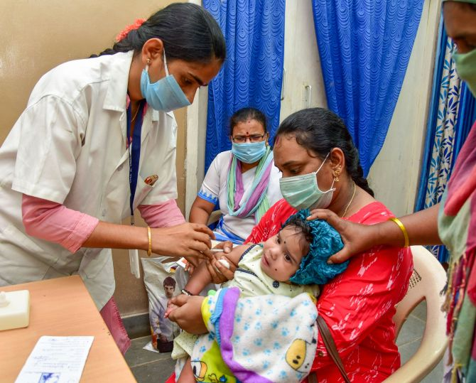
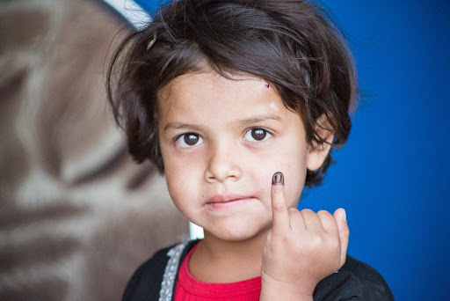
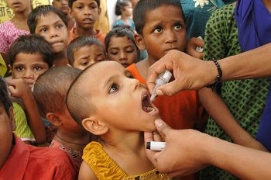
Thank You!!!

